Slide 1
Two-Sample Tests and Confidence Intervals
Chapter 10 (10.1 – 10.2)
Chap 10-<number>

Slide 2
Learning Objectives
In this chapter, you learn:
How to use hypothesis testing for comparing the difference between
  The means of two independent populations
  The means of two related populations
  The proportions of two independent populations
  The variances of two independent populations
  Use of MS Excel to do … all of the above
  (and you can use Excel in your homework too!)
Statistics for Managers Using Microsoft Excel® 7e Copyright ©2014 Pearson Education, Inc.
Chap 10-<number>

Slide 3
Two-Sample Tests
Two-Sample Tests
Population Means, Independent Samples
Population Means, Related Samples
Population Proportions
(later)
Population Variances
Examples:
Group 1 vs. Group 2
Same group before vs. after treatment
Proportion 1 vs. Proportion 2
Variance 1 vs.
Variance 2
Statistics for Managers Using Microsoft Excel® 7e Copyright ©2014 Pearson Education, Inc.
Chap 10-<number>

Slide 4
Difference Between Two Means
Population means, independent samples
*
Goal: Test hypothesis or form a confidence interval for the difference between two population means, μ₁ – μ₂
σ₁ and σ₂ unknown, assumed equal
The point estimate for the difference is
X₁ – X₂
σ₁ and σ₂ unknown, not assumed equal
Statistics for Managers Using Microsoft Excel® 7e Copyright ©2014 Pearson Education, Inc.
Chap 10-<number>

Slide 5
Difference Between Two Means: Independent Samples
Different data sources
  Unrelated
  Independent
    Sample selected from one population has no effect on the sample selected from the other population
Population means, independent samples
*
Use S_{p} to estimate unknown σ. Use a Pooled-Variance t test.
σ₁ and σ₂ unknown, assumed equal
σ₁ and σ₂ unknown, not assumed equal
Use S₁ and S₂ to estimate unknown σ₁ and σ₂. Use a Separate-variance t test
Statistics for Managers Using Microsoft Excel® 7e Copyright ©2014 Pearson Education, Inc.
Chap 10-<number>

Slide 6
Hypothesis Tests for
Two Population Means
Two Population Means, Independent Samples
Lower-tail test:
H₀: μ₁ ≥ μ₂
H₁: μ₁ < μ₂
i.e.,
H₀: μ₁ – μ₂ ≥ 0
H₁: μ₁ – μ₂ < 0
Upper-tail test:
H₀: μ₁ ≤ μ₂
H₁: μ₁ > μ₂
i.e.,
H₀: μ₁ – μ₂ ≤ 0
H₁: μ₁ – μ₂ > 0
Two-tail test:
H₀: μ₁ = μ₂
H₁: μ₁ ≠ μ₂
i.e.,
H₀: μ₁ – μ₂ = 0
H₁: μ₁ – μ₂ ≠ 0
Statistics for Managers Using Microsoft Excel® 7e Copyright ©2014 Pearson Education, Inc.
Chap 10-<number>

Slide 7
Hypothesis tests for μ₁ – μ₂
Two Population Means, Independent Samples
Lower-tail test:
H₀: μ₁ – μ₂ ≥ 0
H₁: μ₁ – μ₂ < 0
Upper-tail test:
H₀: μ₁ – μ₂ ≤ 0
H₁: μ₁ – μ₂ > 0
Two-tail test:
H₀: μ₁ – μ₂ = 0
H₁: μ₁ – μ₂ ≠ 0
α
α
α/2
α/2
-t_{α}
t_{α}
-t_{α/2}
t_{α/2}
Reject H₀ if t_{STAT} < -t_{α}
Reject H₀ if t_{STAT} > t_{α}
Reject H₀ if t_{STAT} < -t_{α/2}
or t_{STAT} > t_{α/2}
Statistics for Managers Using Microsoft Excel® 7e Copyright ©2014 Pearson Education, Inc.
Chap 10-<number>

Slide 8
Hypothesis tests for µ₁ - µ₂ with σ₁ and σ₂ unknown and assumed equal
Population means, independent samples
Assumptions:
Samples are randomly and
independently drawn
Populations are normally
distributed or both sample
sizes are at least 30
Population variances are
unknown but assumed equal
*
σ₁ and σ₂ unknown, assumed equal
σ₁ and σ₂ unknown, not assumed equal
Statistics for Managers Using Microsoft Excel® 7e Copyright ©2014 Pearson Education, Inc.
Chap 10-<number>

Slide 9
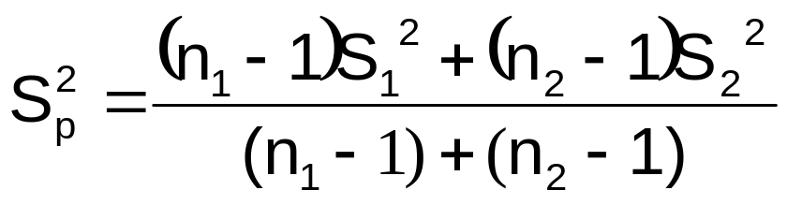
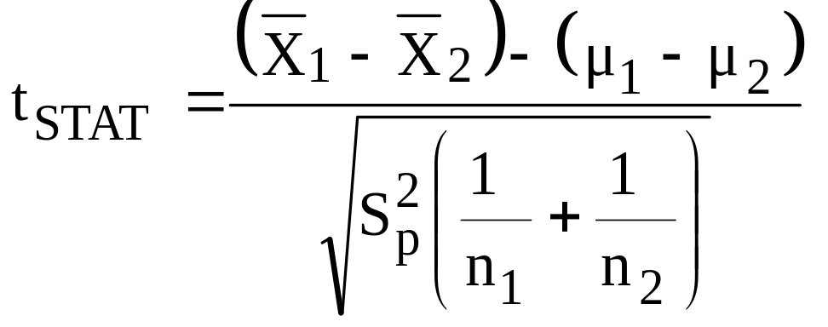
Hypothesis tests for µ₁ - µ₂ with σ₁ and σ₂ unknown and assumed equal
(continued)
The pooled variance is:
The test statistic is:
Where t_{STAT} has d.f. = (n₁ + n₂ – 2)
Population means, independent samples
*
σ₁ and σ₂ unknown, assumed equal
σ₁ and σ₂ unknown, not assumed equal
Statistics for Managers Using Microsoft Excel® 7e Copyright ©2014 Pearson Education, Inc.
Chap 10-<number>

Slide 10
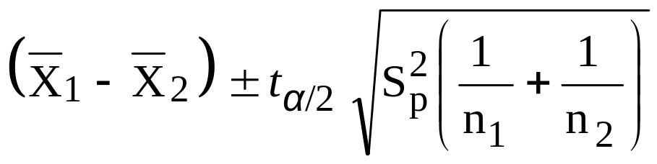
Confidence interval for µ₁ - µ₂ with σ₁ and σ₂ unknown and assumed equal
Population means, independent samples
The confidence interval for
μ₁ – μ₂ is:
Where t_{α/2} has d.f. = n₁ + n₂ – 2
*
σ₁ and σ₂ unknown, assumed equal
σ₁ and σ₂ unknown, not assumed equal
Statistics for Managers Using Microsoft Excel® 7e Copyright ©2014 Pearson Education, Inc.
Chap 10-<number>

Slide 11

Pooled-Variance t Test Example
You are a financial analyst for a brokerage firm. Is there a difference in dividend yield between stocks listed on the NYSE & NASDAQ? You collect the following data:
NYSE NASDAQ
Number 21 25
Sample mean 3.27 2.53
Sample std dev 1.30 1.16
Assuming both populations are
approximately normal with equal variances, is
there a difference in mean
yield (α = 0.05)?
Statistics for Managers Using Microsoft Excel® 7e Copyright ©2014 Pearson Education, Inc.
Chap 10-<number>

Slide 12
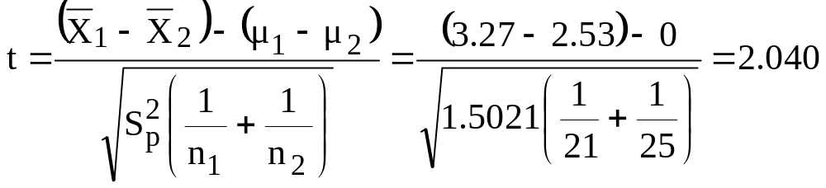
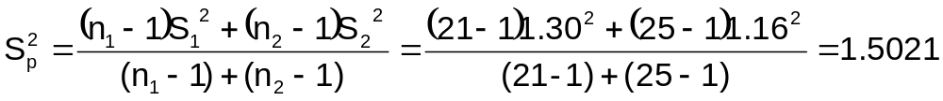
Pooled-Variance t Test Example: Calculating the Test Statistic
(continued)
H0: μ₁ - μ₂ = 0 i.e. (μ₁ = μ₂)
H1: μ₁ - μ₂ ≠ 0 i.e. (μ₁ ≠ μ₂)
The test statistic is:
Statistics for Managers Using Microsoft Excel® 7e Copyright ©2014 Pearson Education, Inc.
Chap 10-<number>

Slide 13
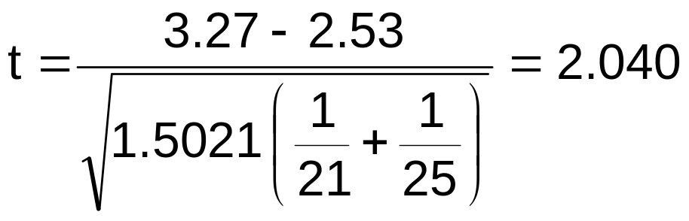
Pooled-Variance t Test Example: Hypothesis Test Solution
H₀: μ₁ - μ₂ = 0 i.e. (μ₁ = μ₂)
H₁: μ₁ - μ₂ ≠ 0 i.e. (μ₁ ≠ μ₂)
α = 0.05
df = 21 + 25 - 2 = 44
Critical Values: t = ± 2.0154
Test Statistic:
Reject H₀
Reject H₀
.025
.025
-2.0154
0
2.0154
t
2.040
Decision:
Conclusion:
Reject H₀ at α = 0.05
There is evidence of a difference in means.
Statistics for Managers Using Microsoft Excel® 7e Copyright ©2014 Pearson Education, Inc.
Chap 10-<number>

Slide 14
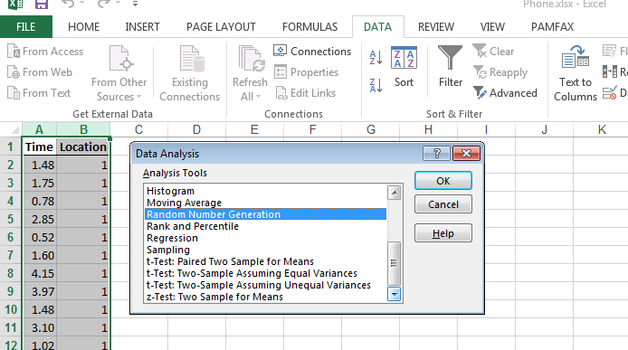
Two-Sample Tests in Excel
Here, column B tells which values belong to which sample

Slide 15
Examples
Page 352, ## 10.1, 10.2, 10.8
Page 353, ## 10.9 (using Excel data analysis toolpak)
Statistics for Managers Using Microsoft Excel® 7e Copyright ©2014 Pearson Education, Inc.
Chap 10-<number>

Slide 16
Hypothesis tests for µ₁ - µ₂ with σ₁ and σ₂ unknown, not assumed equal
Population means, independent samples
Assumptions:
Samples are randomly and
independently drawn
Populations are normally
distributed or both sample
sizes are at least 30
Population variances are
unknown and cannot be
assumed to be equal
σ₁ and σ₂ unknown, assumed equal
*
σ₁ and σ₂ unknown, not assumed equal
Statistics for Managers Using Microsoft Excel® 7e Copyright ©2014 Pearson Education, Inc.
Chap 10-<number>

Slide 17
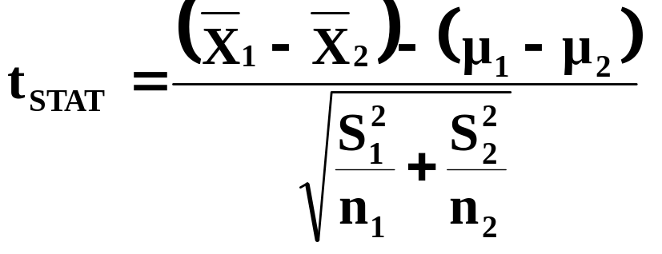
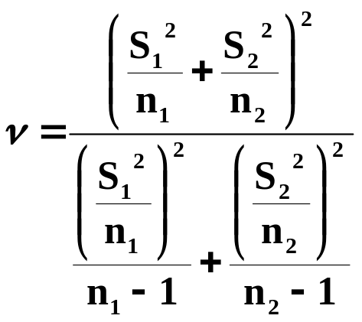
Hypothesis tests for µ₁ - µ₂ with σ₁ and σ₂ unknown and not assumed equal
(continued)
The test statistic is:
Population means, independent samples
σ₁ and σ₂ unknown, assumed equal
t_{STAT} has d.f. ν =
*
σ₁ and σ₂ unknown, not assumed equal
Statistics for Managers Using Microsoft Excel® 7e Copyright ©2014 Pearson Education, Inc.
Chap 10-<number>

Slide 18
Separate-Variance t Test Example
You are a financial analyst for a brokerage firm. Is there a difference in dividend yield between stocks listed on the NYSE & NASDAQ? You collect the following data:
NYSE NASDAQ
Number 21 25
Sample mean 3.27 2.53
Sample std dev 1.30 1.16
Assuming both populations are
approximately normal with unequal variances, is
there a difference in mean
yield (α = 0.05)?
Statistics for Managers Using Microsoft Excel® 7e Copyright ©2014 Pearson Education, Inc.
Chap 10-<number>

Slide 19
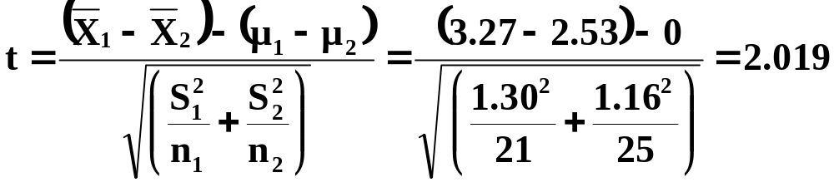
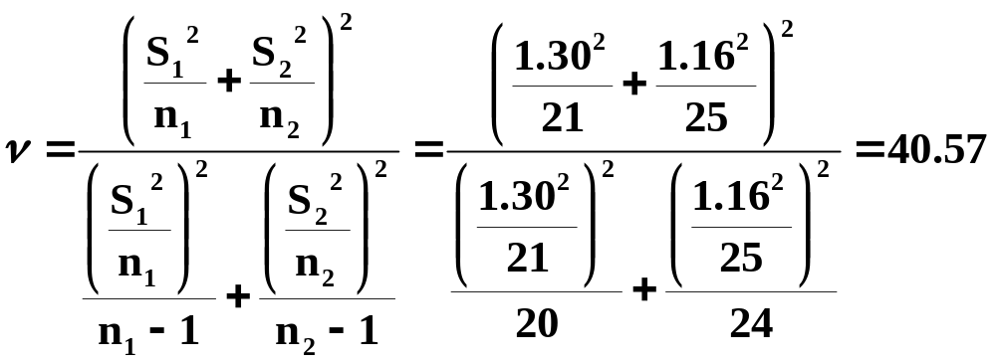
Separate-Variance t Test Example: Calculating the Test Statistic
(continued)
H0: μ₁ - μ₂ = 0 i.e. (μ₁ = μ₂)
H1: μ₁ - μ₂ ≠ 0 i.e. (μ₁ ≠ μ₂)
The test statistic is:
Use degrees of
freedom = 40
Statistics for Managers Using Microsoft Excel® 7e Copyright ©2014 Pearson Education, Inc.
Chap 10-<number>

Slide 20

Separate-Variance t Test Example: Hypothesis Test Solution
H₀: μ₁ - μ₂ = 0 i.e. (μ₁ = μ₂)
H₁: μ₁ - μ₂ ≠ 0 i.e. (μ₁ ≠ μ₂)
α = 0.05
df = 40
Critical Values: t = ± 2.021
Test Statistic:
Reject H₀
Reject H₀
.025
.025
-2.021
0
2.021
t
2.019
Decision:
Conclusion:
Fail To Reject H₀ at α = 0.05
There is no evidence of a difference in means.
Statistics for Managers Using Microsoft Excel® 7e Copyright ©2014 Pearson Education, Inc.
Chap 10-<number>

Slide 21
Examples
Page 354, ## 10.14-10.15 (using Excel data analysis toolpak)
Statistics for Managers Using Microsoft Excel® 7e Copyright ©2014 Pearson Education, Inc.
Chap 10-<number>

Slide 22
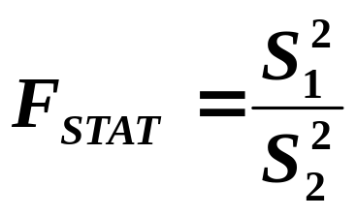
The F Distribution
The F critical value is found from the F table
There are two degrees of freedom required: numerator and denominator
The larger sample variance is always the numerator
When
In the F table,
  numerator degrees of freedom determine the column
  denominator degrees of freedom determine the row
df₁ = n₁ – 1 ; df₂ = n₂ – 1
Statistics for Managers Using Microsoft Excel® 7e Copyright ©2014 Pearson Education, Inc.
Chap 10-<number>

Slide 23
Finding the Rejection Region
H₀: σ₁² = σ₂²
H₁: σ₁² ≠ σ₂²
H₀: σ₁² ≤ σ₂²
H₁: σ₁² > σ₂²
α/2
F
α
0
0
F
Do not
reject H₀
F_{α/2}
Reject H₀
Do not
reject H₀
F_{α}
Reject H₀
Reject H₀ if F_{STAT} > F_{α/2}
Reject H₀ if F_{STAT} > F_{α}
Statistics for Managers Using Microsoft Excel® 7e Copyright ©2014 Pearson Education, Inc.
Chap 10-<number>

Slide 24
F Test: An Example
You are a financial analyst for a brokerage firm. You want to compare dividend yields between stocks listed on the NYSE & NASDAQ. You collect the following data:
NYSE NASDAQ
Number 21 25
Mean 3.27 2.53
Std dev 1.30 1.16
Is there a difference in the variances between the NYSE & NASDAQ at the α = 0.05 level?
Statistics for Managers Using Microsoft Excel® 7e Copyright ©2014 Pearson Education, Inc.
Chap 10-<number>

Slide 25
F Test: Example Solution
Form the hypothesis test:
  H₀: σ²₁ = σ²₂ (there is no difference between variances)
  H₁: σ²₁ ≠ σ²₂ (there is a difference between variances)
Find the F critical value for α = 0.05:
Numerator d.f. = n₁ – 1 = 21 –1 =20
Denominator d.f. = n2 – 1 = 25 –1 = 24
F_{α/2} = F_{.025, 20, 24} = 2.33
Statistics for Managers Using Microsoft Excel® 7e Copyright ©2014 Pearson Education, Inc.
Chap 10-<number>

Slide 26
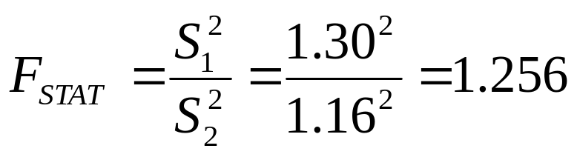
F Test: Example Solution
(continued)
The test statistic is:
H₀: σ₁² = σ₂²
H₁: σ₁² ≠ σ₂²
α/2 = .025
0
F
Do not
reject H₀
Reject H₀
F_{STAT} = 1.256 is not in the rejection region, so we do not reject H₀
F_{0.025}=2.33
Conclusion: There is not sufficient evidence of a difference in variances at α = .05
Statistics for Managers Using Microsoft Excel® 7e Copyright ©2014 Pearson Education, Inc.
Chap 10-<number>

Slide 27
Examples
Page 377, #10.58, 10.60
Statistics for Managers Using Microsoft Excel® 7e Copyright ©2014 Pearson Education, Inc.
Chap 10-<number>

Slide 28
Related Populations
The Paired Difference Test
Tests Means of 2 Related Populations
      Paired or matched samples
      Repeated measures (before/after)
      Use difference between paired values:
Eliminates Variation Among Subjects
Assumptions:
  Both Populations Are Normally Distributed
  Or, if not Normal, use large samples
Related samples
  D_{i} = X_{1i} - X_{2i}
Statistics for Managers Using Microsoft Excel® 7e Copyright ©2014 Pearson Education, Inc.
Chap 10-<number>

Slide 29
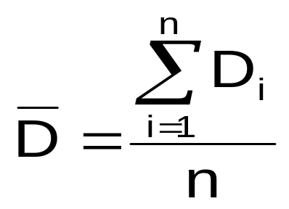
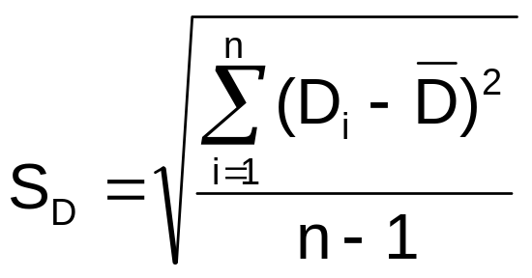
Related Populations
The Paired Difference Test
(continued)
The i^{th} paired difference is D_{i} , where
Related samples
  D_{i} = X_{1i} - X_{2i}
The point estimate for the paired difference population mean μ_{D} is D :
The sample standard deviation is S_{D}
n is the number of pairs in the paired sample
Statistics for Managers Using Microsoft Excel® 7e Copyright ©2014 Pearson Education, Inc.
Chap 10-<number>

Slide 30
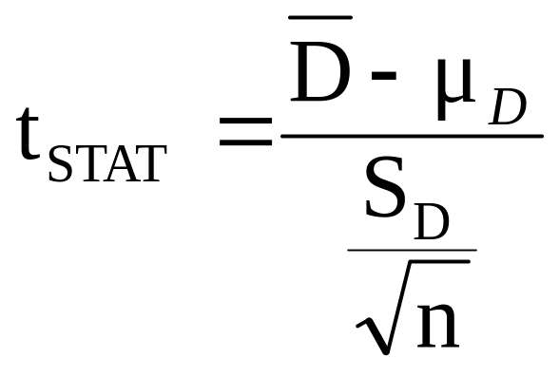
The Paired Difference Test:
Finding t_{STAT}
The test statistic for μ_{D} is:
Paired samples
Where t_{STAT} has n - 1 d.f.
Statistics for Managers Using Microsoft Excel® 7e Copyright ©2014 Pearson Education, Inc.
Chap 10-<number>

Slide 31
The Paired Difference Test: Possible Hypotheses
Paired Samples
Lower-tail test:
H₀: μ_{D} ≥ 0
H₁: μ_{D} < 0
Upper-tail test:
H₀: μ_{D} ≤ 0
H₁: μ_{D} > 0
Two-tail test:
H₀: μ_{D} = 0
H₁: μ_{D} ≠ 0
α
α
α/2
α/2
-t_{α}
t_{α}
-t_{α/2}
t_{α/2}
Reject H₀ if t_{STAT} < -t_{α}
Reject H₀ if t_{STAT} > t_{α}
Reject H₀ if t_{STAT} < -t_{α/2}
or t_{STAT} > t_{α/2}
Where t_{STAT} has n - 1 d.f.
Statistics for Managers Using Microsoft Excel® 7e Copyright ©2014 Pearson Education, Inc.
Chap 10-<number>

Slide 32
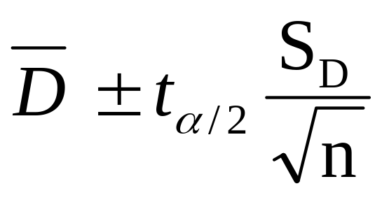
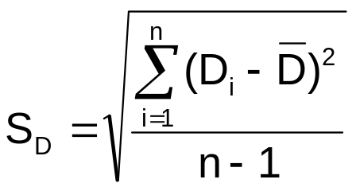
The Paired Difference Confidence Interval
The confidence interval for μ_{D} is
Paired samples
where
Statistics for Managers Using Microsoft Excel® 7e Copyright ©2014 Pearson Education, Inc.
Chap 10-<number>

Slide 33
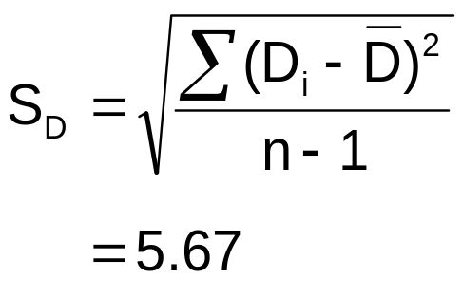
Paired Difference Test: Example
Assume you send your salespeople to a “customer service” training workshop. Has the training made a difference in the number of complaints? You collect the following data:
Number of Complaints: (2) - (1)
Salesperson Before (1) After (2) Difference, D_{i}
C.B. 6 4 - 2
T.F. 20 6 -14
M.H. 3 2 - 1
R.K. 0 0 0
M.O. 4 0 - 4
-21
Σ
D_{i}
D =
n
= -4.2
Statistics for Managers Using Microsoft Excel® 7e Copyright ©2014 Pearson Education, Inc.
Chap 10-<number>

Slide 34
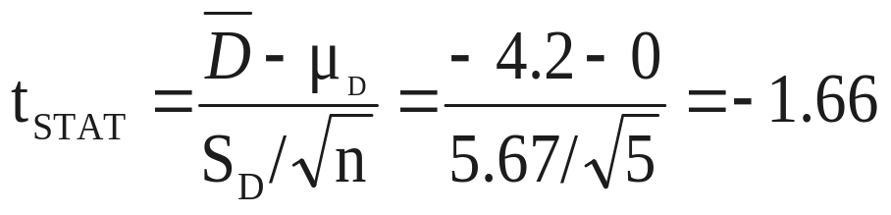
Paired Difference Test: Solution
Has the training made a difference in the number of complaints (at the 0.01 level)?
Reject
Reject
H₀: μ_{D} = 0
H₁: μ_{D} ≠ 0
α/2
α/2
α = .01
D =
- 4.2
- 4.604 4.604
- 1.66
t_{0.005} = ± 4.604 d.f. = n - 1 = 4
Decision: Do not reject H₀
(t_{stat} is not in the reject region)
Test Statistic:
Conclusion: There is not a significant change in the number of complaints.
Statistics for Managers Using Microsoft Excel® 7e Copyright ©2014 Pearson Education, Inc.
Chap 10-<number>

Slide 35
Testing for the Ratio Of Two Population Variances
Hypotheses F_{STAT}
*
Tests for Two
Population
Variances
H₀: σ₁² = σ₂²
H₁: σ₁² ≠ σ₂²
S₁² / S₂²
H₀: σ₁² ≤ σ₂²
H₁: σ₁² > σ₂²
F test statistic
Where:
S₁² = Variance of sample 1 (the larger sample variance)
n₁ = sample size of sample 1
S₂² = Variance of sample 2 (the smaller sample variance)
n₂ = sample size of sample 2
n₁ –1 = numerator degrees of freedom
n₂ – 1 = denominator degrees of freedom
Statistics for Managers Using Microsoft Excel® 7e Copyright ©2014 Pearson Education, Inc.
Chap 10-<number>

Slide 36
Examples
Page 368, #10.30
Page 377, #10.60
Statistics for Managers Using Microsoft Excel® 7e Copyright ©2014 Pearson Education, Inc.
Chap 10-<number>

Slide 37
Chapter Summary
In this chapter we discussed
Comparing two independent samples
  Pooled-variance t test for the difference in two means
  Separate-variance t test for difference in two means
  Confidence intervals for the difference between two means
  F test for the ratio of two population variances
Comparing two related samples (paired samples)
  Performed paired t test for the mean difference
  Formed confidence intervals for the mean difference
Statistics for Managers Using Microsoft Excel® 7e Copyright ©2014 Pearson Education, Inc.
Chap 10-<number>

